Slide 1

A Comparison of Petrophysically Derived Post Refrac Recoverable Oil and Gas with Offset New Well EUR Results
URTeC 4042322
Robert E. Barba
Petrophysicist
Integrated Energy Services, Inc.

Slide 2
Estimating Post Recompletion Uplift
A key input for the economic evaluation and derisking of organic shale recompletions (formerly called “refracs”*) is the expected recoverable oil or gas following the recompletion
The two primary methods used are:
Offset new completion EUR/ft type curve:
  Estimating the expected EUR/ft of lateral for offset new wells
  Adjusting the EUR for the recompletion candidate’s lateral length
  Subtract the cumulative production
OIP or GIP and expected recovery factor:
  Estimate the OIP or GIP from petrophysical analysis
  Applying the expected max recovery factors for fluid phase and well spacing
  Subtract the cumulative production
*Barba April 2024 SPE JPT Guest Editorial

Slide 3

Author’s License Plate
Committed to Recompletions!
Slides available on request

Slide 4
Webb Co EFS Condensate Window Refrac EUR vs Two Methods
Total EUR BCFE/1000 ft of Lateral
I’m a petrophysicist-where did you think I was going with this comparison?
Guilty of the “when all you have is a hammer” to some extent
Remainder of the presentation explains why the offset new well EUR/ft method is clearly flawed

Slide 5
Offset EUR per Foot Type Curve Method
Select correlative recent completions in the area
Develop a type curve for these completions
Generate the EUR/ft for the modern recompletion
  EUR = lateral length * EUR/ft
Subtract the cumulative production to obtain an estimate of post recompletion recoverable oil or gas
Allocate the recoverable hydrocarbons over a 30 year period using month to month decline rates from new well type curves in the area
  Recompletions typically have identical “b” factors to offset new wells
  This is not the case with refracs through existing perforations

Slide 6
EUR per Foot Method Critical Assumption
Key assumption is 100% cluster efficiency for both
EFS and HVS recompletions have artificially high cluster efficiencies most likely due to fracture reorientation*
In 100% of the pads in the EFS and HVS the recompleted wells had the highest total recovery factors on the pad
This is most likely due to the horizontal stress anisotropy prior to pressure depletion leading to planar fractures with relatively narrow drainage normal to the fracture vs a more complex geometry in the recompletions due to stress reorientation
*URTeC 3724057 and SPE 213075

Slide 7
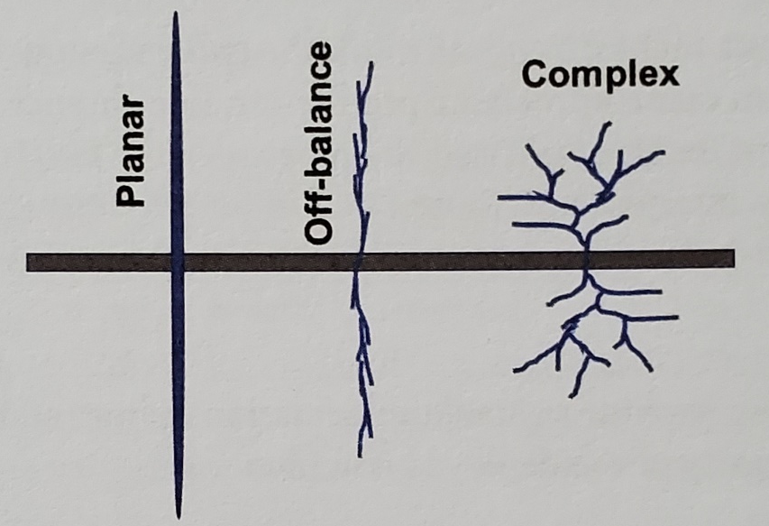
Possible Result of Stress Reorientation EFS and HVS
More isotropic
recompletions
Barnett like
wide SRVs
EFS and HVS
Anisotropic
new wells
most reservoirs
URTeC 3724057 five recompletions 73 BO/ft EUR vs seven new wells 45 BO/ft
Low perforation delta p in both groups (284 psi new wells 502 psi recompletions vs 2000+ needed)
Reorientation clearly seen in COP offset pressure monitoring lateral 70 ft away (White 2022)
Not observed in DVN offset pressure monitoring lateral 220 ft away (GTI project)
Possibly far field fractures more planar with the highest complexity closer to the laterals?
For skeptics what is the mechanism that results in recompletions consistently having the above results and higher total recovery factors than new wells?
Diagram from Ali Daneshy

Slide 8
New Completion Cluster Efficiency Evaluation
The petrophysical analysis model was applied to 146 new well completions in the Eagle Ford to estimate recovery factors for new wells from their EURs and oil or gas in place
The recovery factors were compared to the maximum recovery factor for the well spacing to get a “completion efficiency” estimate
In the absence of parent-child issues this should be a good proxy for cluster efficiency
The results were consistent with the findings from an extensive 4500 stage step down test analysis (Taprock/Churchwell et al 2023) where multiple phased perforations with low perforation friction pressure drops had lower than optimum cluster efficiencies

Slide 9
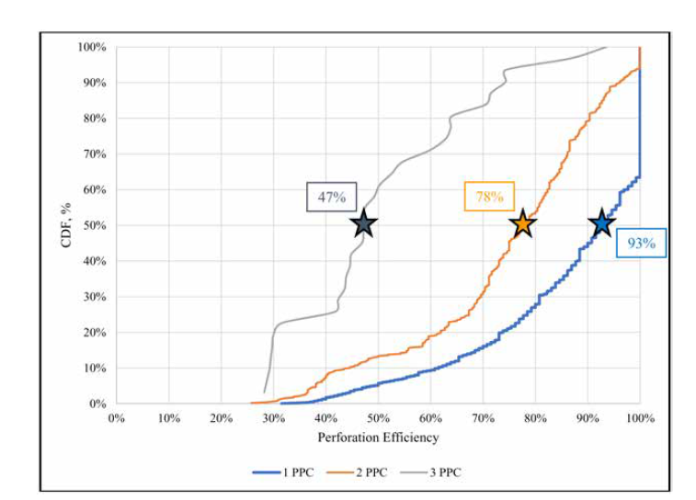
4500 Step Down Test Cluster Efficiency Distribution
XLE 2 Holes 78%
Non XLE phased 47%
XLE 1 Hole 93%
Taprock study SPE 212345

Slide 10
New Well Cluster Efficiency vs Perforation Delta P
Cluster Efficiency
Pre-Erosion Perforation Friction
Taprock study SPE 212345

Slide 11
Cluster Efficiency vs Perforation Delta P
Red from 4500 well study/Green from production data

Slide 12
New Completion Cluster Efficiency Evaluation
The wells in the three areas were in different parts of the Eagle Ford
All were completed from 2019 on with close cluster spacings and high proppant and fluid loadings
This comparison completely invalidates the use of offset type curves to forecast the total EUR per foot from a recompletion
If it is used the P5 EUR/ft is probably the best criteria vs the more traditional P50 and even then it may be too low
  Analogous to plotting TVD vs temperature highest points are used
It is proposed that the OIP and RF method are better criteria to forecast recompletion total recovery post recompletion than any type curve based method

Slide 13
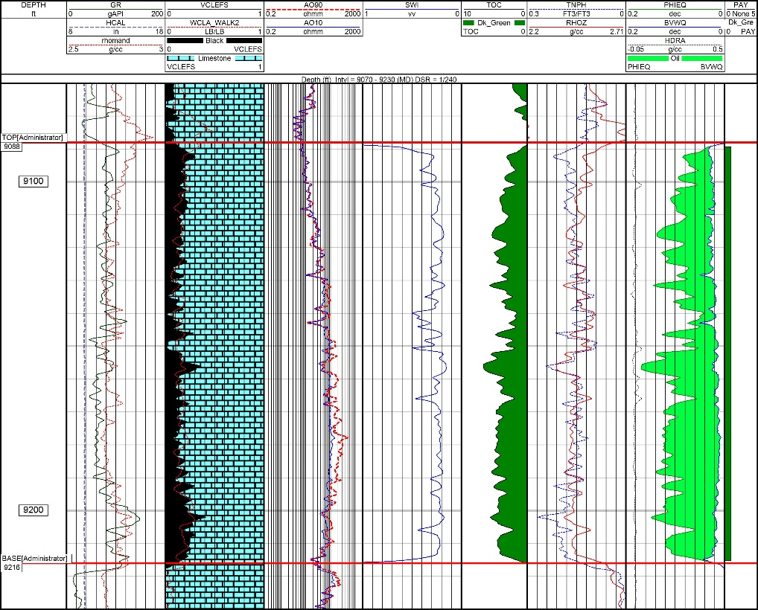
OIP per Acre Source (Calibrated Petrophysics)

Slide 14
OIP/acre vs EUR/ft
BO EUR/ft (OIP*max RF for well spacing)
OIP/acre

Slide 15
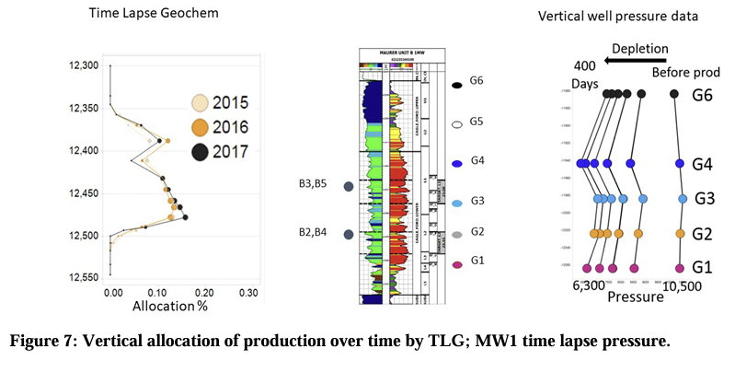
Eagle Ford Producing Height Assumption Support
150’producing
55’ Propped
Total pay thickness 257 ft
Urtec 2570 COP Raterman et al 2020

Slide 16
Well Spacing vs Maximum Recovery Factor
Oil Gas Condensate (MCFE/OGIP)
>=660 14%
>=880 65%
Maximum oil recovery factor
Average Well Spacing ft
Quick calculation 2% of oil spacing and 7% of gas condensate spacing
Dry gas 1320 spacing close to stand alone, 42% of spacing = quicklook maximum recovery factor
Drainage area for recovery factor oil window = 660*Perf Interval/43560

Slide 17
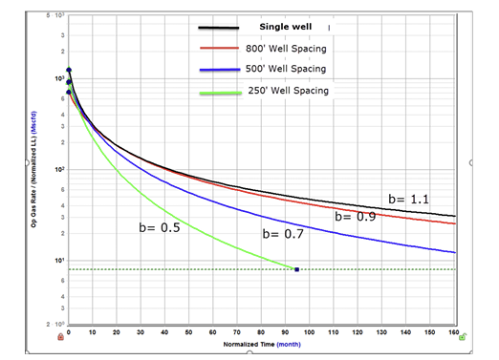
Gas Condensate 880 ft Spacing Support
800 ft spacing close to stand alone “b” factor
URTeC 2695433

Slide 18
OIP Method vs Offset New Well EUR/ft Area 1
Total EUR (Recompletion Uplift plus Cum Oil)

Slide 19
OIP Method Results Eagle Ford-All 5 Refracs
Total EUR (Recompletion Uplift plus Cum Oil)

Slide 20
Estimating Post Recompletion Uplift
A key input for the economic evaluation and derisking of organic shale recompletions (formerly called “refracs”) is the expected production following the recompletion
The oil in place and recovery factor method is significantly more realistic than assuming that offset new wells will provide a proxy for post recompletion total EUR
If limited openhole log data is available the P5 EUR/ft from offsets is probably a better metric than the traditional P50 method and even that optimistic criteria may be pessimistic

