Slide 1


Subsurface Consultants & Associates, LLC
An International Consultancy & Training Company

Slide 2


“Best Practices” for New Well Fracs and Legacy Well Recompletions Course
November 14-15, 2024
Houston, Texas
Robert Barba
Instructor

Slide 3
Size of the Refrac Recompletion Prize
An economic analysis of stranded hydrocarbons was done for 25 all legacy well pads in the Eagle Ford
It was assumed that the “best practices” taught in the course would be followed and the completions would have high cluster efficiency
Since recompletions re-orient in the Eagle Ford recovery of 100% of the stranded reserves was assumed
19 of the 25 pads met a 3:1 ROI criteria with 56 wells
Economics of a hypothetical 56 well recompletion program are presented on the next slide

Slide 4
19 EFS Pads Current PV10 vs Expected Post Recompletion NPV10
PV10 discounted cash flow

Slide 5
Estimating Post Recompletion Uplift
A key “best practice” for recompletions (formerly called “refracs”*) is the expected recoverable oil or gas following the recompletion to derisk the candidate selection process
The three primary methods used are:
Offset new completion EUR/ft type curve:
  Estimating the expected EUR/ft of lateral for offset new wells
  Adjusting the EUR for the recompletion candidate’s lateral length
  Subtract the cumulative production
Offset Recompletion EUR/ft:
  Estimate EUR/ft and adjust for spacing if closer than unhindered
  Unhindered oil 660 ft condensate 880 ft gas 1320 ft
OIP or GIP and expected recovery factor (preferred method):
  Estimate the OIP or GIP from petrophysical analysis
  Applying the expected max recovery factors for fluid phase and well spacing
  Subtract the cumulative production
*Barba April 2024 SPE JPT Guest Editorial

Slide 6
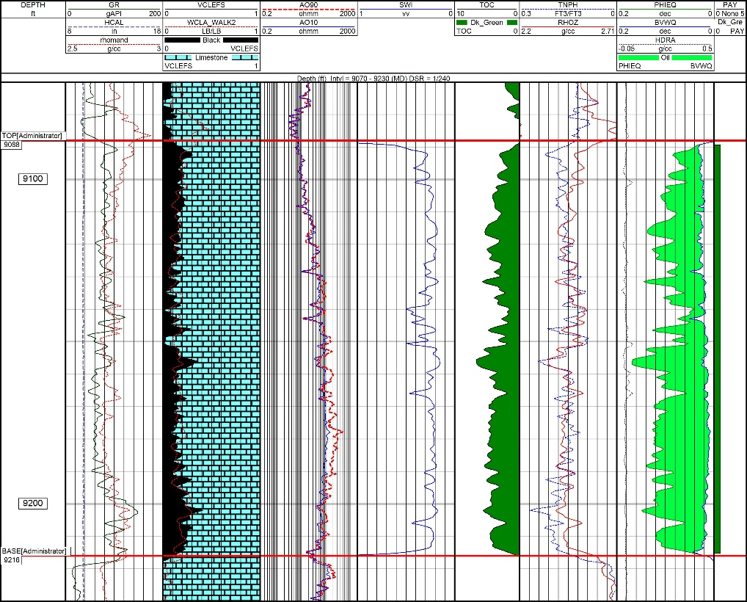
OIP per Acre Source
Recovery Factor =(EUR/ac)/(OIP/ac)
Acreage assumptions : Oil 660 width Gas condensate 880’ Dry gas 1320’

Slide 7
Webb Co Eagle Ford Condensate EUR BCFE/1000’
Total EUR BCFE/1000 ft of Lateral
I’m a petrophysicist-where did you think I was going with this comparison?
Guilty of the “when all you have is a hammer” to some extent
Remainder of the presentation explains why the offset new well EUR/ft method is clearly flawed

Slide 8
Offset EUR/Foot Type Curve Method
Select recent completions in the area with similar fluid properties, similar oil or gas in place, and similar well spacings to the recompletion candidate
Develop a type curve for these completions to obtain an estimate of the expected total EUR per foot for the modern recompletion
  EUR = lateral length * EUR/ft
Subtract the cumulative production to obtain an estimate of post recompletion recoverable oil or gas
Allocate the recoverable hydrocarbons over a 30 year period using month to month decline rates from new well type curves in the area
  Recompletions typically have identical “b” factors to offset new wells
  This is not the case with refracs through existing perforations

Slide 9
New Well Cluster Efficiency vs Perforation Delta P
Pre-Erosion Perforation Friction
Cluster Efficiency
Taprock study SPE 212345

Slide 10
OIP Method vs Offset New Well EUR/ft Area 1
Total EUR (Recompletion Uplift plus Cum Oil)

Slide 11
Offset Recompletion EUR Normalization for Well Spacing
>= 660 ft = 14% RF
% of Maximum EUR
Well Spacing ft
One major Eagle Ford operators parent wells average 330 ft spacing
200 MBO EUR 330 ft spacing = 400 MBO with >-660 spacing
Over 1/3 of Eagle Ford wells have wide spacings

Slide 12
Summary OIP and Recovery Factor vs Offset New Well Results
This comparison completely invalidates the use of offset new well type curves to forecast the total EUR per foot from a recompletion
If it is used the P5 EUR/ft is probably the best criteria vs the more traditional P50 and even then it may be too low
  Analogous to plotting TVD vs temperature use highest points
Offset actual recompletions can be used if the results are normalized to differences in candidate and analog spacing
It is proposed that the OIP and maximum recovery factor method should be used to forecast total recovery post recompletion than any offset new well type curve based method or un-normalized recompletions
That is the method we teach in the class

Slide 13
Course Content
1. Top ten reasons to refrac a well
2. Where have refracs worked and what are the economics?
3. Why refracs work in organic shales
4. Why refracs work in matrix permeability reservoirs
5. Refrac candidate selection in organic shales
6. Refrac candidate selection in matrix permeability reservoirs
7. Derisking wellbore mechanical integrity issues
8. “Best practices” for isolating existing perforations
9. “Best practices” to maximize recovery factors
10. “Best practices” to protect infill wells from asymmetric fracs
11. Booking behind pipe reserves with refracs
12. Case studies in organic shale and conventional reservoirs

Slide 14
Recompletion Optimization Course Details
Two days at the SCA facility in west Houston, next open course date November 14-15, 2024
  In-house sessions available
Afternoon of second day dedicated time for individual student case studies to develop customized models for their areas of operation
For this course an analysis of a legacy pad is included for each operator in attendance
  Students need to provide LAS files, core and any specialty log data, and offset production analysis

Slide 15
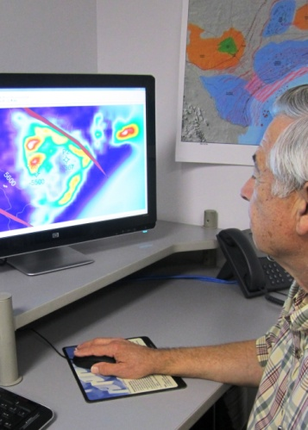

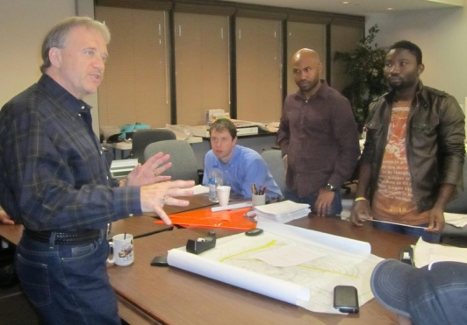
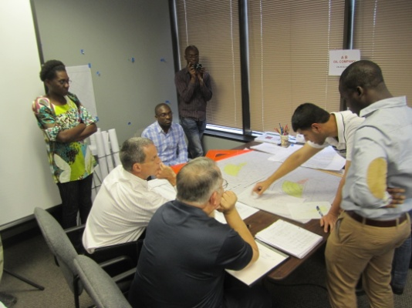
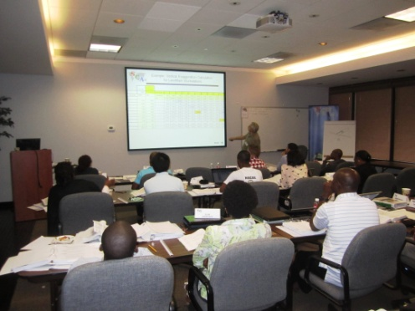
Choose SCA:
Global Knowledge, Global Reach
Consulting ♦ Direct Hire ♦ Project & Studies ♦ Training
Corporate Headquarters
10700 Richmond Ave., Suite 325
Houston, Texas 77042
Phone: +1.713.789.2444
Fax: +1.713.789.4449

